Slide 1
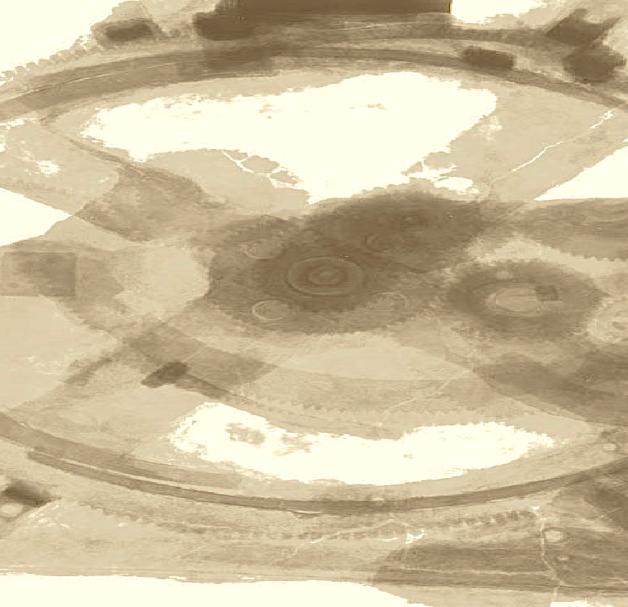

Drops of LTSpice
Using arbitrary current sources as Loads

Slide 2
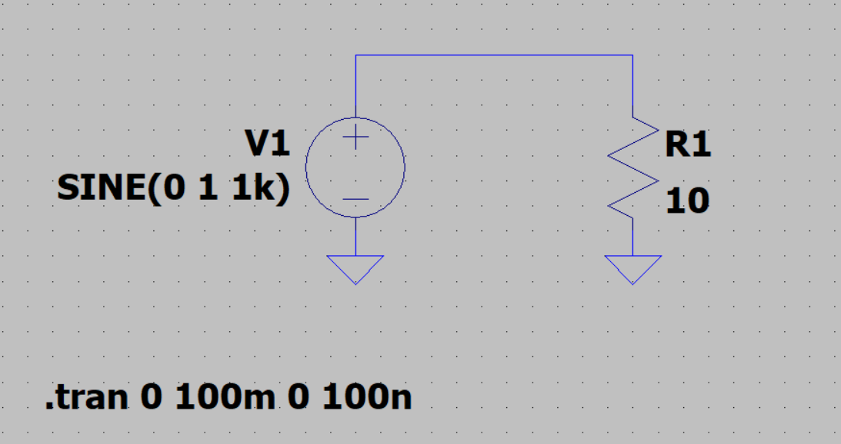
Everyone has done something like this…
It is a voltage source and a load. It could not be simpler.

Slide 3
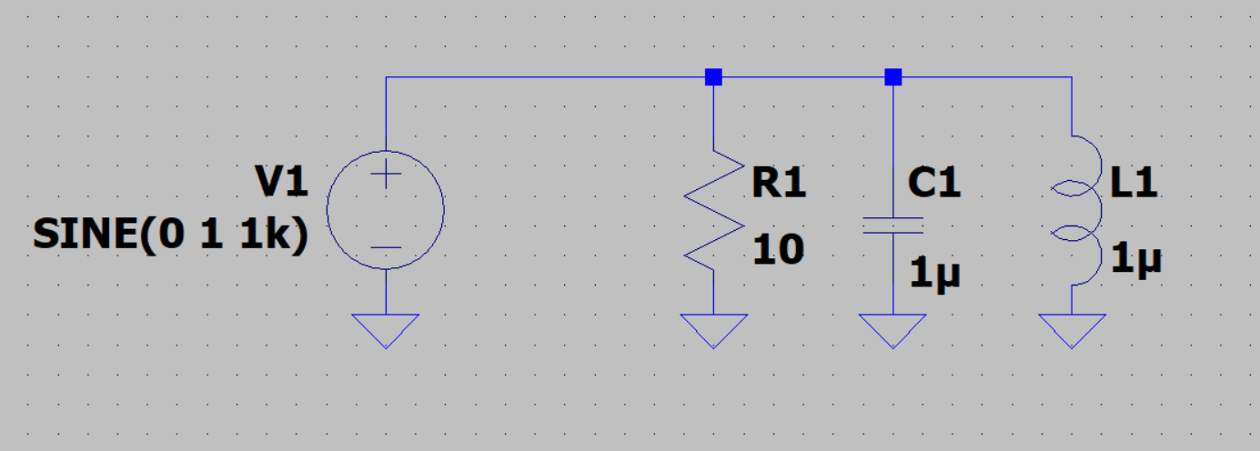
But... what about when we need more complex loads?
Can we simplify this?

Slide 4
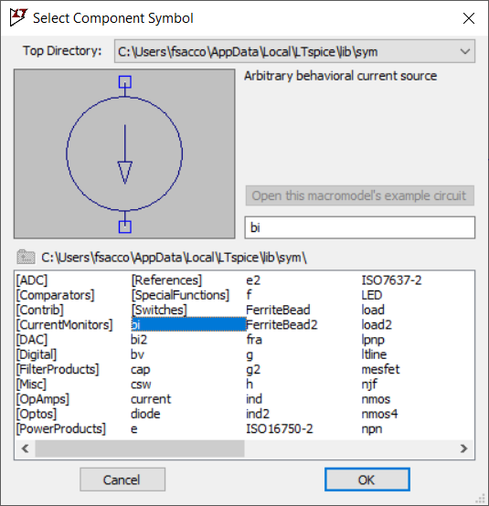
Yes! Using the Arbitrary Behavioral Current Source.
It is possible to implement a chain based on a mathematical function.

Slide 5
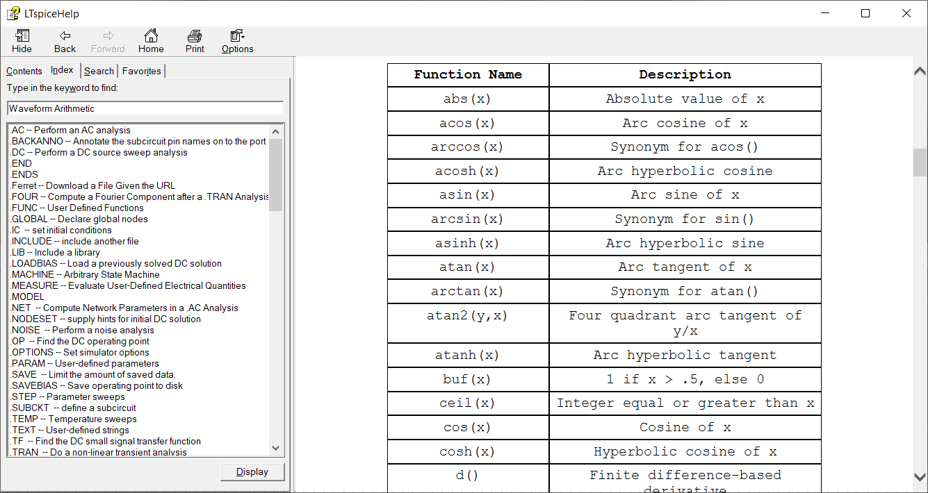
And this component respects the same mathematical functions that we saw previously.

Slide 6
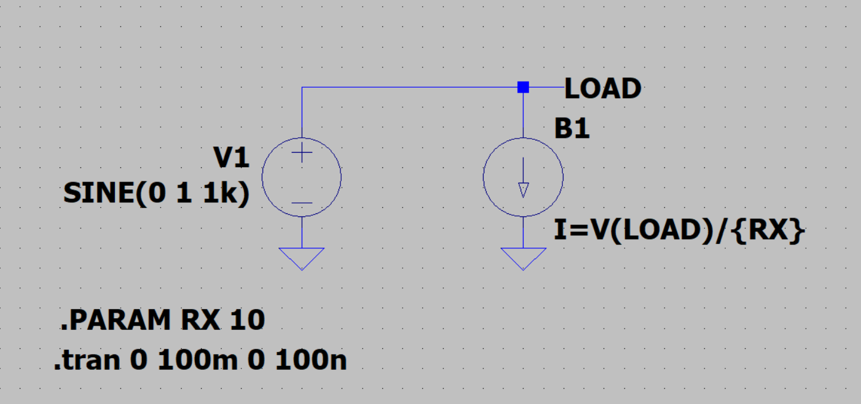
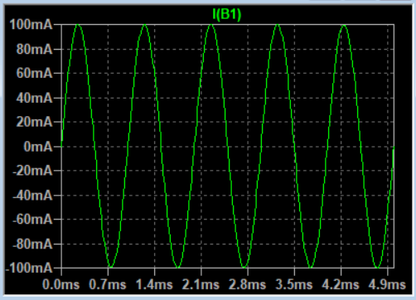
For example…
once we know that I=V/R, it is easy to create a resistive load.

Slide 7
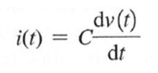
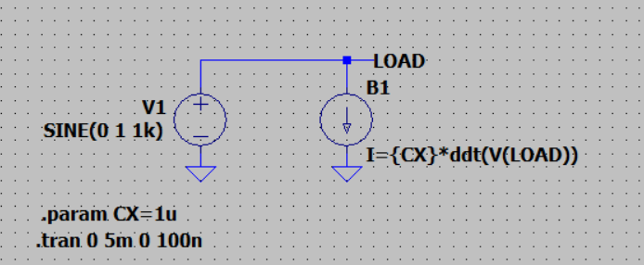
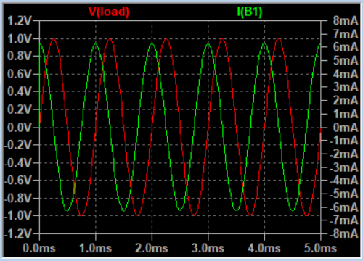
The current over a capacitor is:
The math function ddt() can do this job.

Slide 8
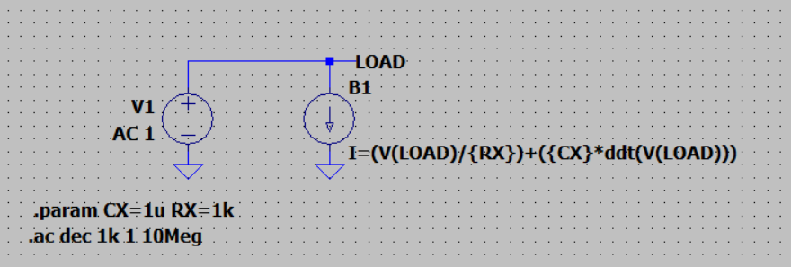
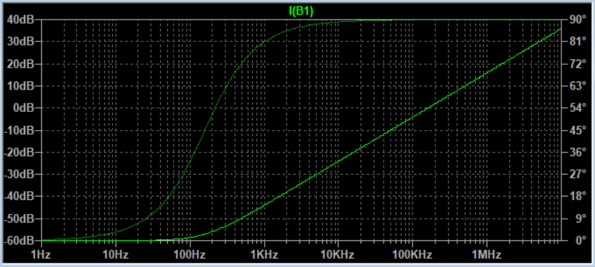
A composition of fillers can be made. Here we have a resistive load in series with a capacitive one.
It is even possible run an AC analysis on loads like this.

Slide 9
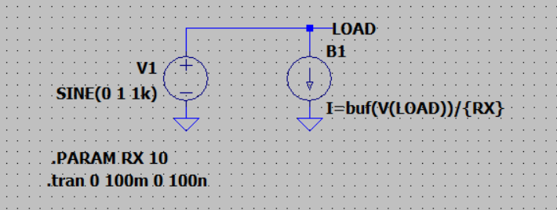
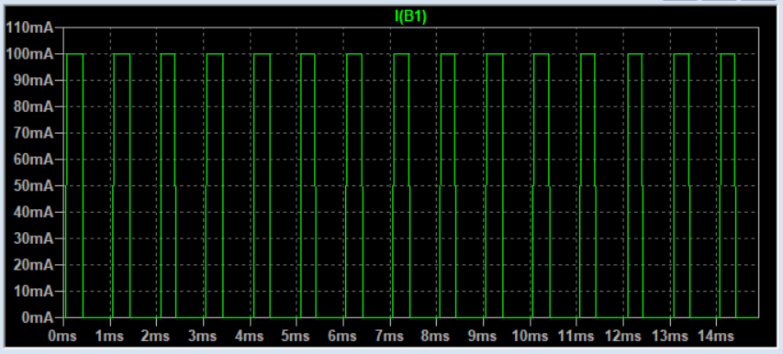
It is the perfect solution for complex and non-linear loads.
Francesco Sacco
linkedin.com/in/saccofrancesco

